Slide 1

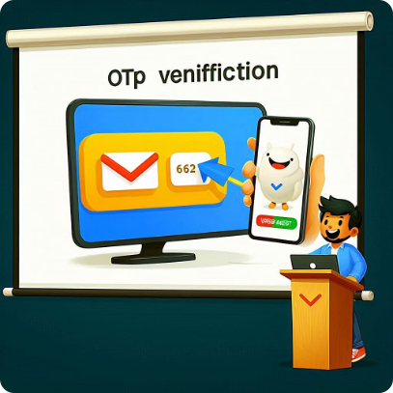
OTP Verification System in Python
Explore the creation of a robust One-Time Password (OTP) verification system using Python, ensuring secure user authentication.

Slide 2

Introduction to OTP
1
What is OTP?
2
Enhanced Security
3
Widespread Usage
A unique, temporary code used to authenticate a user's identity.
Provides an additional layer of protection beyond traditional login credentials.
Commonly used in banking, e-commerce, and other sensitive transactions.

Slide 3

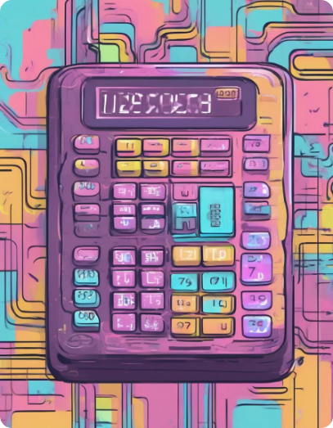
Generating Random OTP
1
Using Randomness
Leveraging Python's random module to create a unique OTP.
2
Set OTP Length
Determine the appropriate length for your OTP, typically 4-6 digits.
3
Store OTP Securely
Ensure the OTP is stored safely, either in memory or a database.

Slide 4

Sending OTP via SMS or Email
SMS Integration
Email Integration
Reliable Delivery
. Use a third-party SMS gateway to deliver the OTP to the user's phone
Send the OTP to the user's registered email address for verification.
Ensure the OTP is delivered promptly and securely to the user.

Slide 5

Verifying OTP Input
User Input
Authentication Result
Prompt the user to enter the OTP received via SMS or email.
Provide feedback on the success or failure of the OTP verification.
1
2
3
Match Against Stored OTP
Verify the user's input against the OTP stored in your system.

Slide 6
Handling OTP Expiration
Time-Based Expiration
Single-Use OTPs
Set a time limit for the OTP, after which it becomes invalid.
Ensure each OTP can only be used once for added security.
Automatic Invalidation
Retry Mechanism
Automatically invalidate expired OTPs to prevent unauthorized access.
Allow users to request a new OTP if the previous one has expired.

Slide 7



Implementing Two-Factor Authentication
Username/Password
OTP Verification
Secure Access
Traditional login with username and password.
Prompt the user to enter the OTP received on their device.
Grant the user access only upon successful OTP verification.

Slide 8


Conclusion and Next Steps
Implement a robust OTP verification system in Python to enhance the security of your applications.
Explore advanced techniques like biometric authentication and hardware security keys for even stronger multi-factor authentication.

Slide 9


